Slide 1
Difference in Degrees of Satisfaction Towards the Main Restaurant of Students Across Grades 10-12 in Beijing National Day School International Department
Lenny Liu, Andy Du

Slide 2
Abstract
Students' studies and living rely on restaurants.
Good restaurant enhances students’ fitness and study efficiency.
Objective: Investigate the degree of satisfaction across three different grades.
Method: Data sampling and Chi-square test of homogeneity.
Conclusion: No significant difference among the three grades.
Suggestions and improvements for the restaurant.

Slide 3
Introduction
Importance of restaurants for students.
Objective: Assess and compare different grades' ratings of BNDS's cafeterias.
Observational study.
Explore changes in students' satisfaction with time.
Provide insights for decision-making and improvements in cafeteria services.

Slide 4
Background Research
Three research studies referred:
High school students' recommendations to improve school food environments: insights from a critical stakeholder group.
Factors in the school cafeteria influencing food choices by high school students.
Increasing the attractiveness of college cafeteria food: A reactance theory perspective.
Gain knowledge on constructing suitable questions, analyzing results, and providing suggestions.

Slide 5
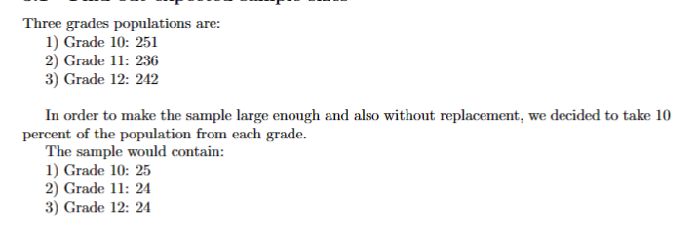
Methods, Procedures, and Result
Determine expected sample sizes for each grade based on their populations.
Conduct a survey with two main questions: satisfaction and reason
Sampling methods: random sampling, cluster sampling.
Present collected responses in tables and a side-by-side bar graph.

Slide 6
Collected responses:
1)Grade 10: 31
2)Grade 11: 26
3)Grade 12: 27
Randomly delete excess responses.

Slide 7
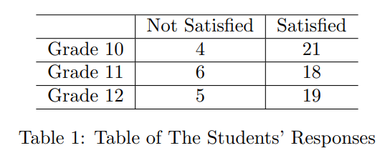
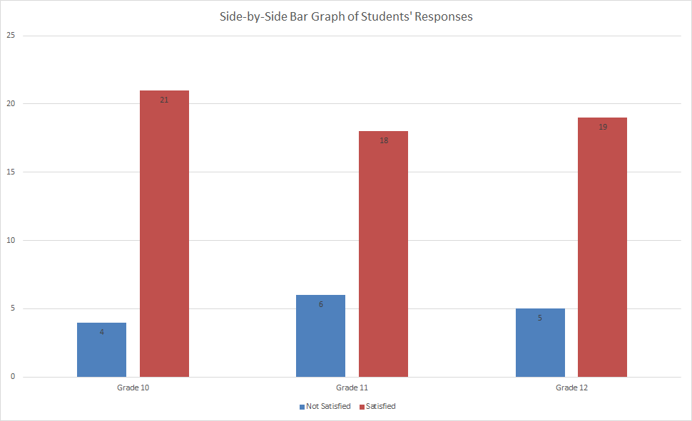
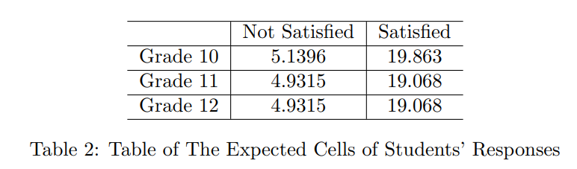
Tables and Graph

Slide 8
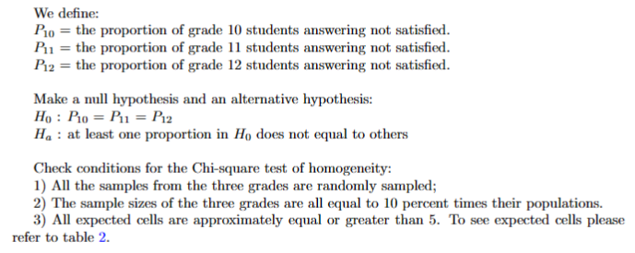

Slide 9
Chi-square test of homogeneity:
χ² = 0.60931226
p-value = 0.73737689
degree of freedom = 2
Fail to reject null hypothesis.
Similar degree of satisfaction among three grades.

Slide 10
Problems and Future Expectation
Potential voluntary bias in data collection for grade 10 and grade 11.
Future projects should use in-person surveys and randomly select students to avoid bias.

Slide 11
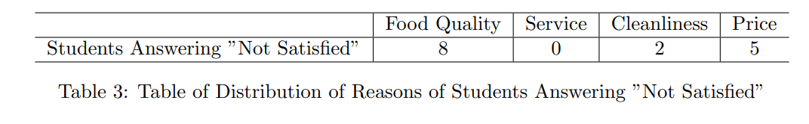
Conclusion
No significant difference in degree of satisfaction among students from three grades.
Satisfaction doesn't decrease much over time.
Most common reasons for "Not Satisfied": food quality and price.
Suggestions: maintain cleanliness and service, improve food quality, and lower prices.

Slide 12
